Slide 1
Modeling lake metabolism using high-frequency deployment sondes
Emanuel Mauch

Slide 2
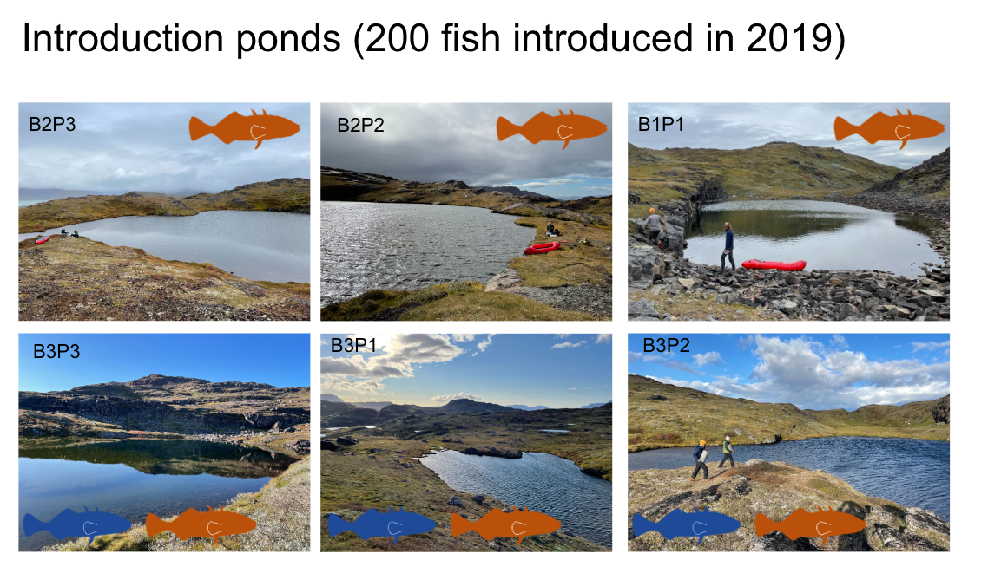
Background
Sticklebacks introduced in 6 experimental ponds in Greenland, 2019

Slide 3
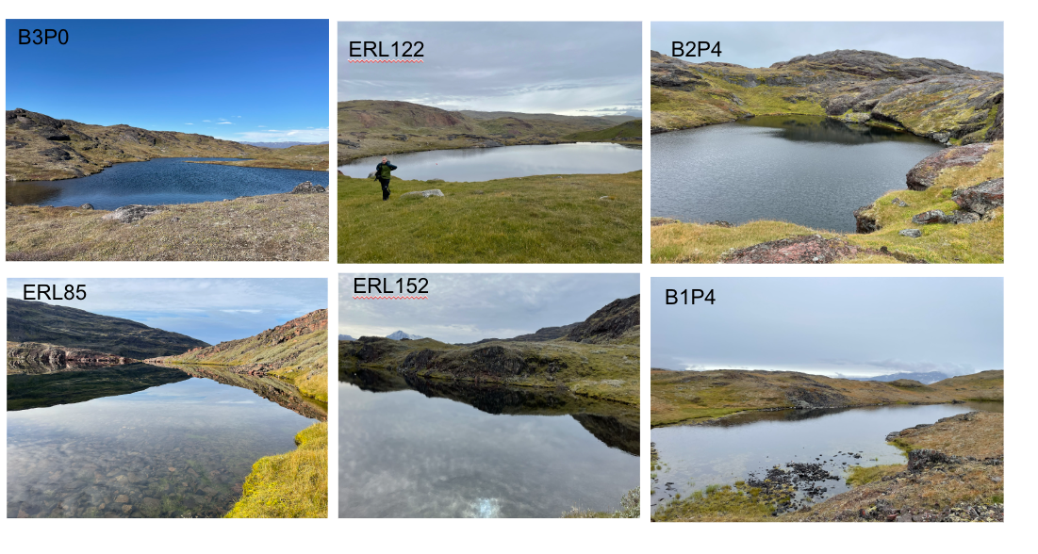
Background
6 ponds used as fishless reference

Slide 4
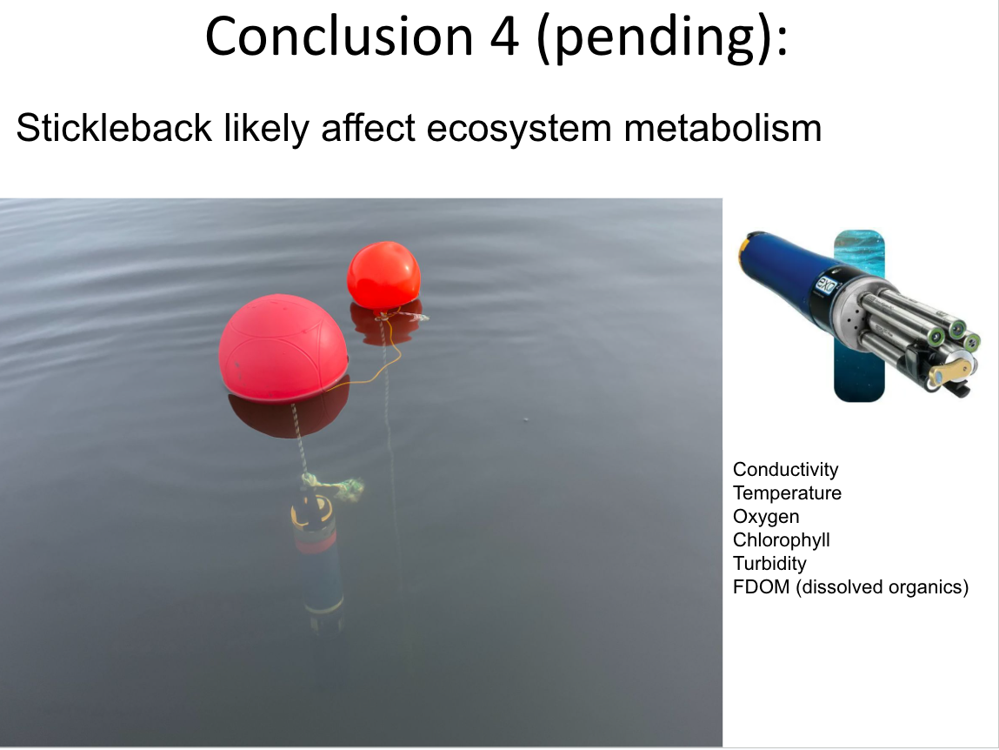
Background
From the year 2021, all 12 lakes were monitored for several days every summer
Deployment sondes were used to measure various water-related parameters
1 sonde per lake
Measurements every 2 to 5 minutes

Slide 5
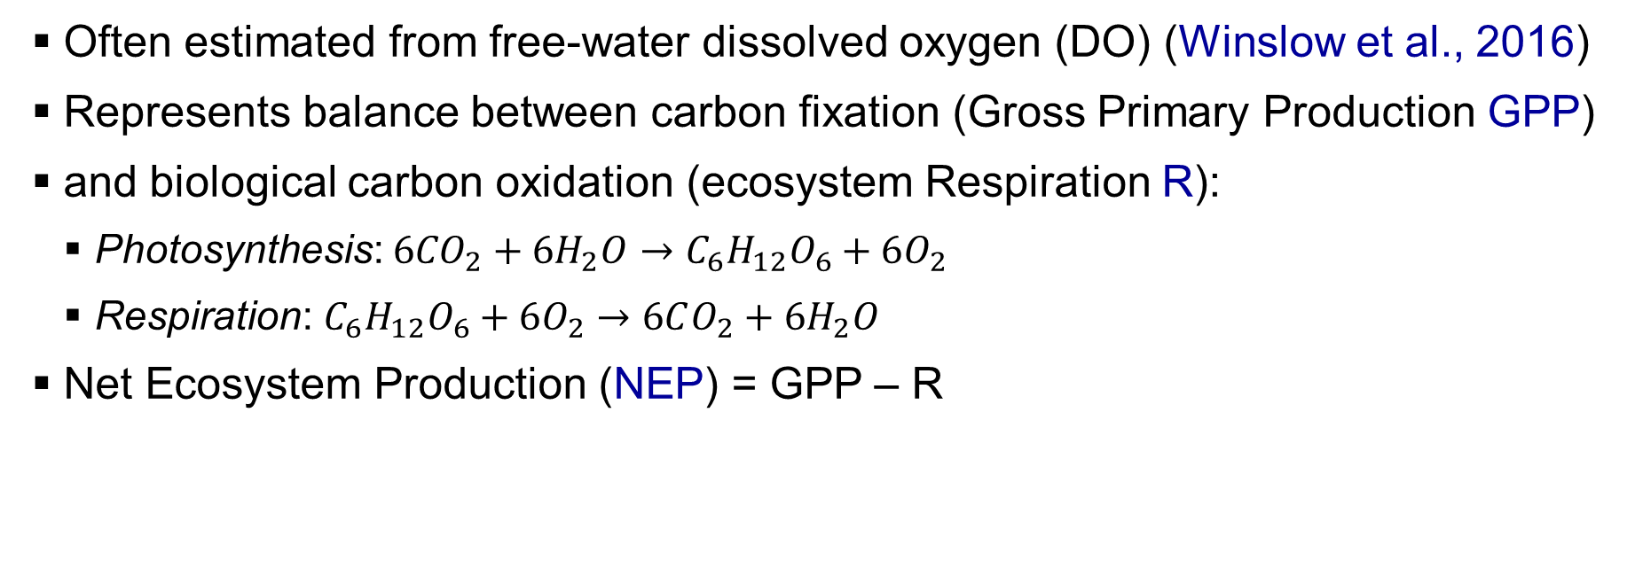
Background: Lake Metabolism
Often estimated from free-water dissolved oxygen (DO) (Winslow et al., 2016)
Represents balance between carbon fixation (Gross Primary Production GPP)
and biological carbon oxidation (ecosystem Respiration R):
Photosynthesis: $6{CO}_{2}+6H_{2}O→C_{6}H_{12}O_{6}+6O_{2}$
Respiration: $C_{6}H_{12}O_{6}+6O_{2}→6CO_{2}+6H_{2}O$
Net Ecosystem Production (NEP) = GPP – R
light

Slide 6
Background: Lake Metabolism
Atmospheric O₂
Air-water gas transfer
H₂O
Photosynthesis
Dissolved
O₂
Respiration
CO₂
Adapted from
Holtgrieve et al., 2010

Slide 7
Research question
How do Sticklebacks affect lake metabolism?

Slide 8
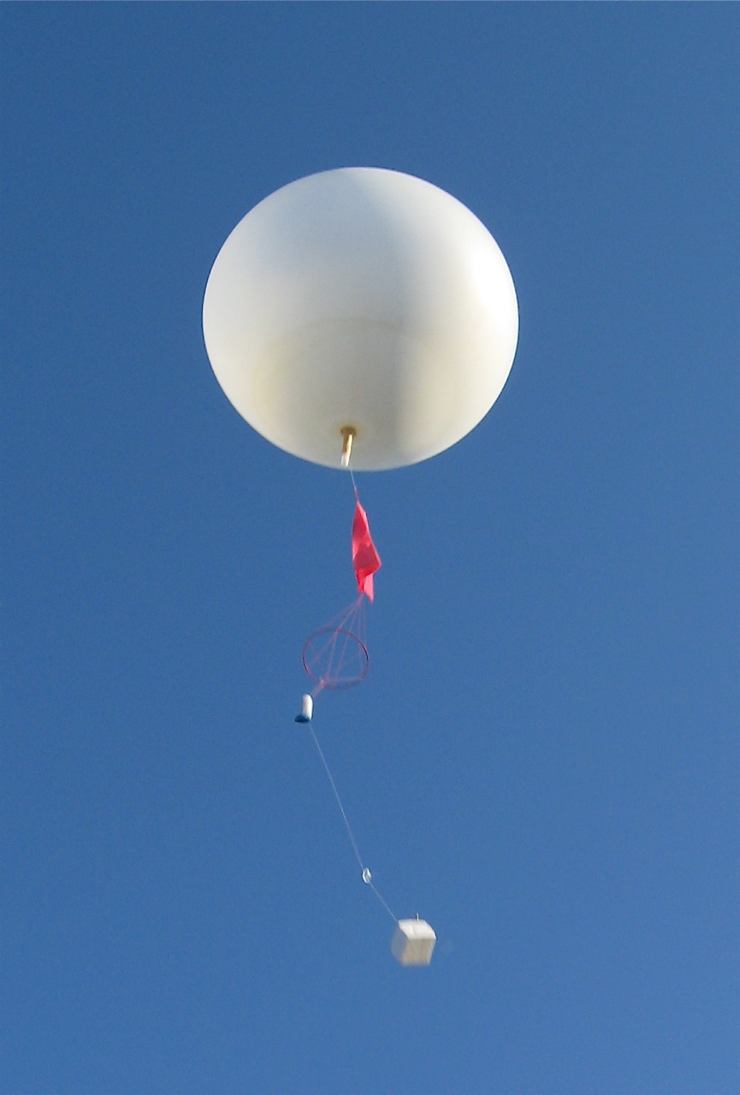
Methods: Data sources
Time-series data from deployment sondes
Wind data from radiosonde in Narsarsuaq (https://www.dmi.dk/lokationarkiv/show/GL/3421711/Narsarsuaq/#arkiv)
Irradiation data from QAS_L automated weather station near Narsarsuaq (https://dataverse.geus.dk/dataset.xhtml?persistentId=doi:10.22008/FK2/IW73UU)
Using downwelling shortwave irradiation (tilt corrected)

Slide 9
Methods: Workflow data preparation
Import raw sonde data
Merge into single dataset
Outlier removal
Quality check with control plots
Cut dataset for equal start and end times
Impute missing values for metabolism modeling

Slide 10
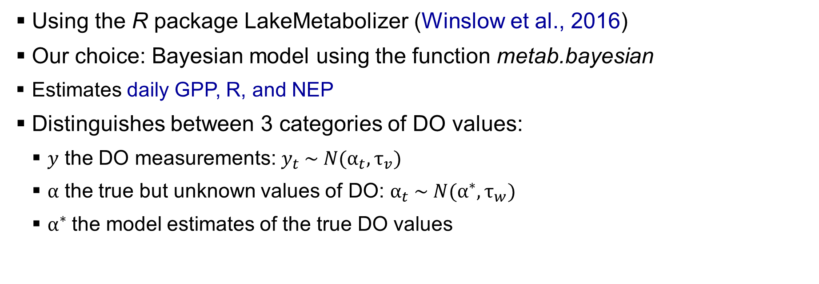
Methods: Bayesian lake metabolism model
Using the R package LakeMetabolizer (Winslow et al., 2016)
Our choice: Bayesian model using the function metab.bayesian
Estimates daily GPP, R, and NEP
Distinguishes between 3 categories of DO values:
$y$ the DO measurements: $y_{t} \sim N(α_{t}, τ_{v})$
$α$ the true but unknown values of DO: $α_{t} \sim N(α^{∗}, τ_{w})$
$α^{∗}$the model estimates of the true DO values

Slide 11
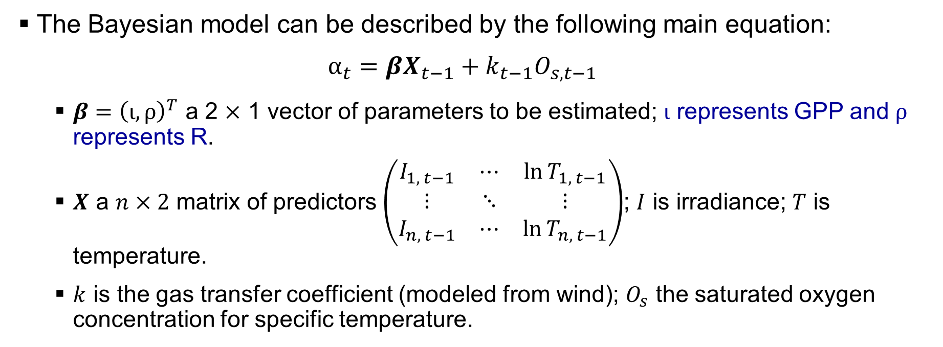
Methods: Bayesian lake metabolism model
The Bayesian model can be described by the following main equation:
$$α_{t}={βX}_{t−1}+k_{t−1}O_{s, t−1}$$
$β={\left(ι, ρ\right)}^{T}$ a 2 $×$ 1 vector of parameters to be estimated; $ι$ represents GPP and $ρ$ represents R.
$X$ a $n×2$ matrix of predictors $\left(\begin{matrix}I_{1, t−1} & ⋯ & \ln{T_{1, t−1}} \\ ⋮ & ⋱ & ⋮ \\ I_{n, t−1} & ⋯ & \ln{T_{n, t−1}}\end{matrix}\right)$; $I$ is irradiance; $T$ is temperature.
$k$ is the gas transfer coefficient (modeled from wind); $O_{s}$ the saturated oxygen concentration for specific temperature.

Slide 12
Methods: Bayesian lake metabolism model
Required input data:
DO observations (mg L⁻¹)
Saturated DO concentration for specific temperature (mg L⁻¹)
Calculated from water temperature
Gas and temperature specific gas transfer coefficient (m⁻¹)
Estimated from wind data
Photosynthetically active radiation (µmol m⁻² s⁻¹)
Calculated from irradiation data
Mixed layer depth (m)
Water temperature (°C)

Slide 13
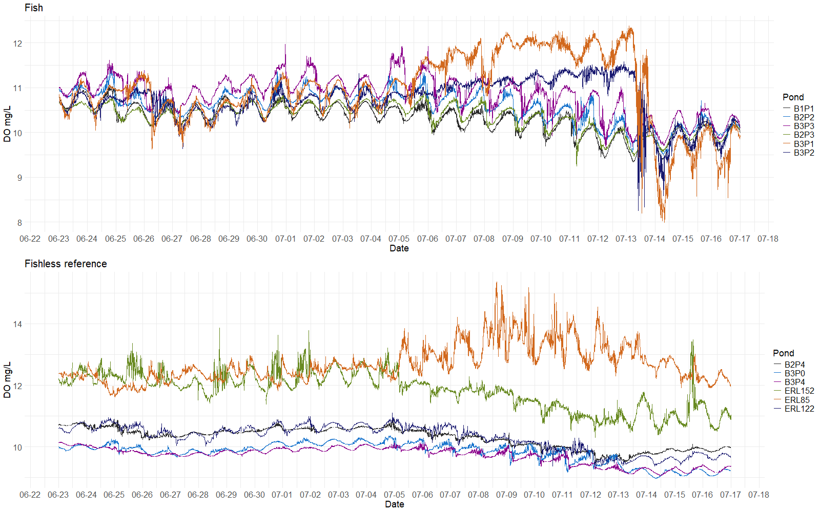
Results: Data preparation 2023 – Dissolved Oxygen

Slide 14
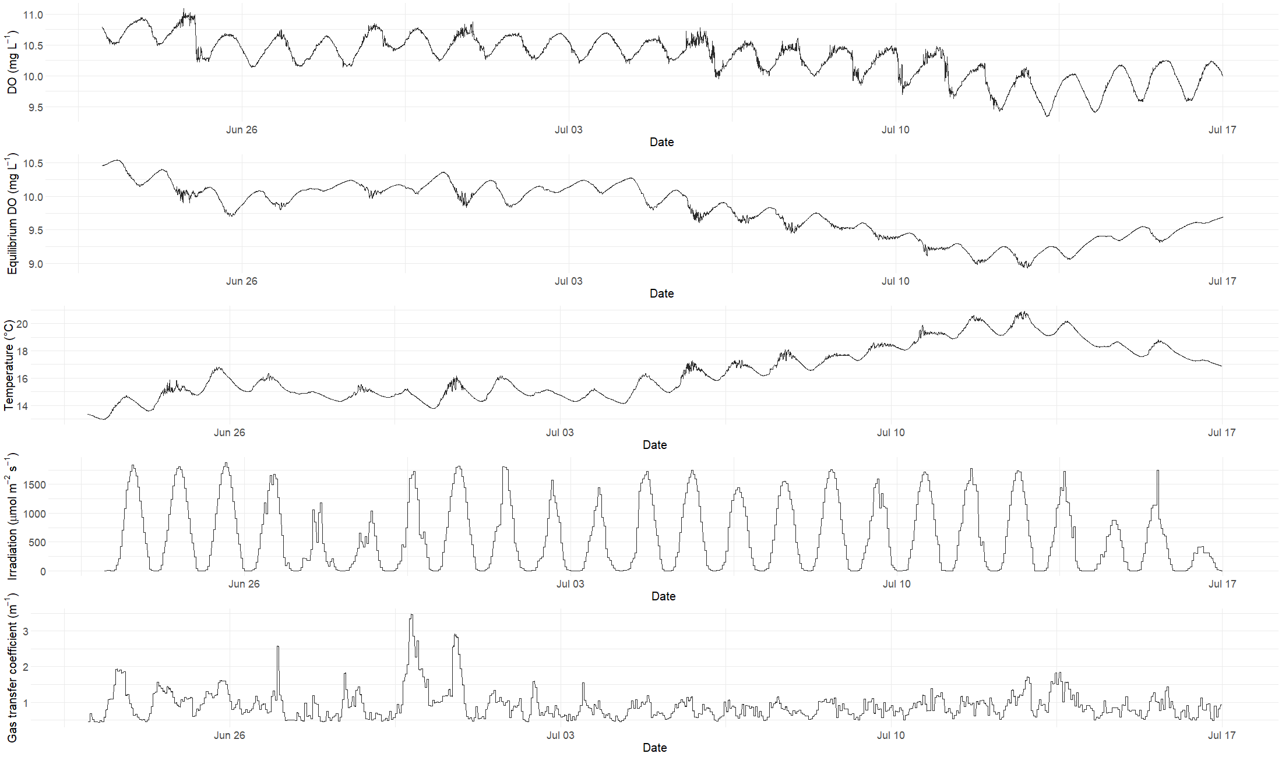
Results: Parameters used to estimate lake metabolism – Example of B1P1 in 2023

Slide 15
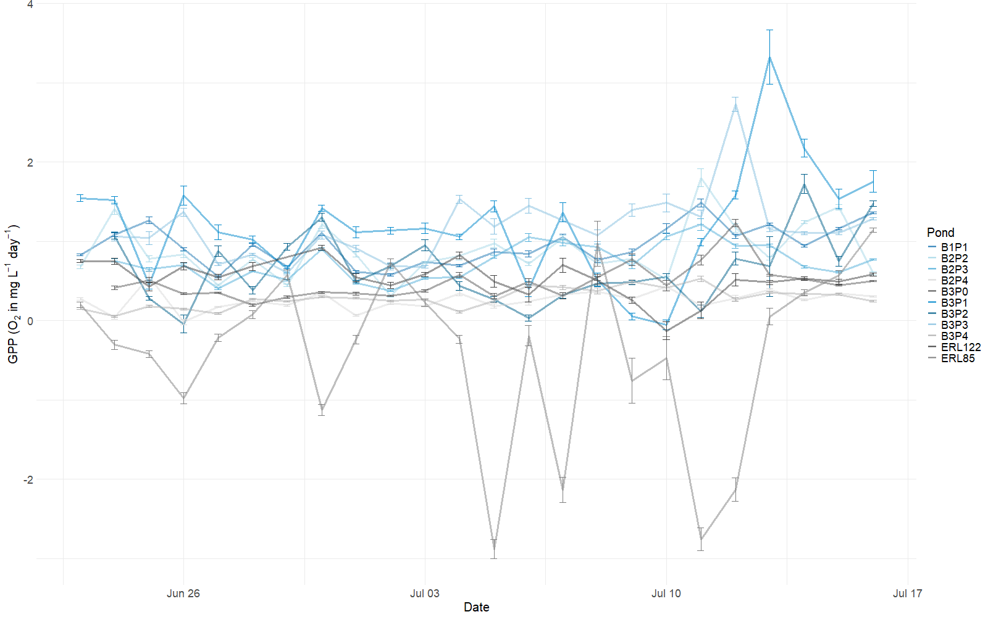
Results: GPP 2023

Slide 16
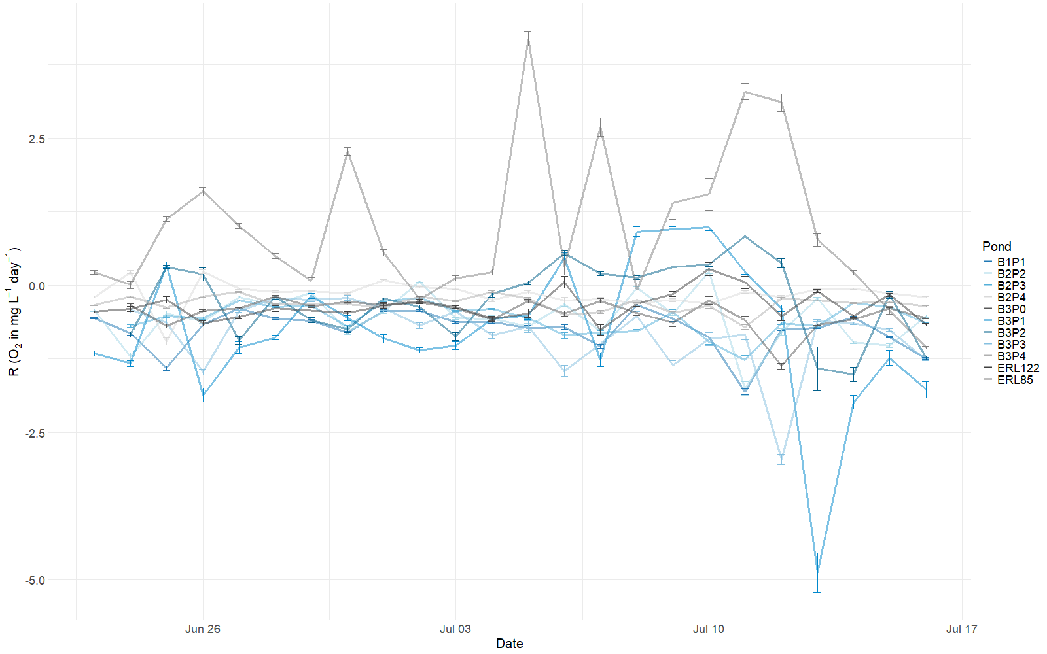
Results: R 2023

Slide 17
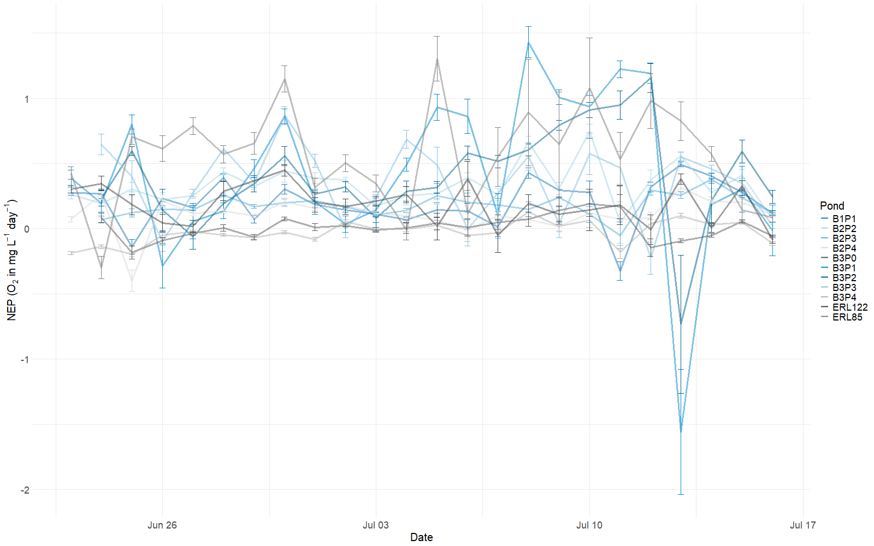
Results: NEP 2023

Slide 18
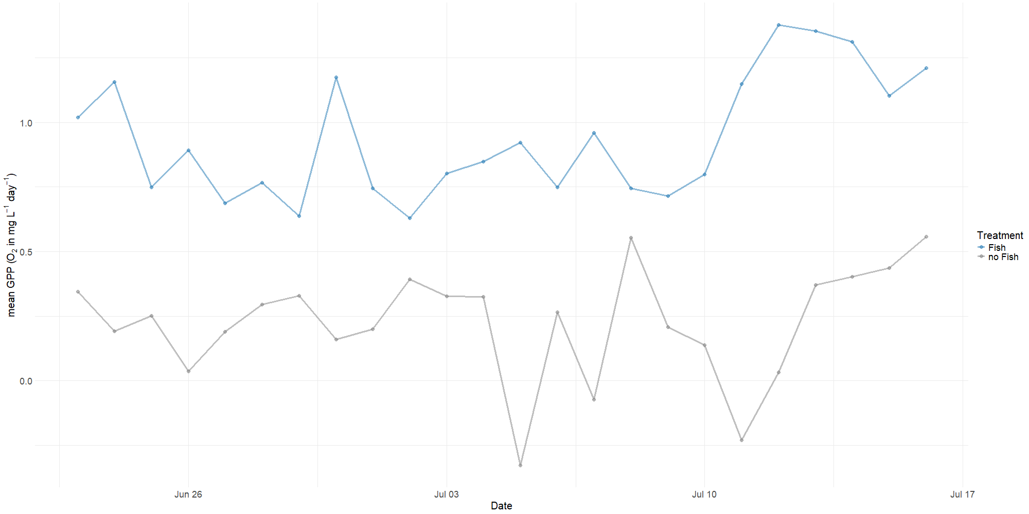
Results: GPP daily means 2023

Slide 19
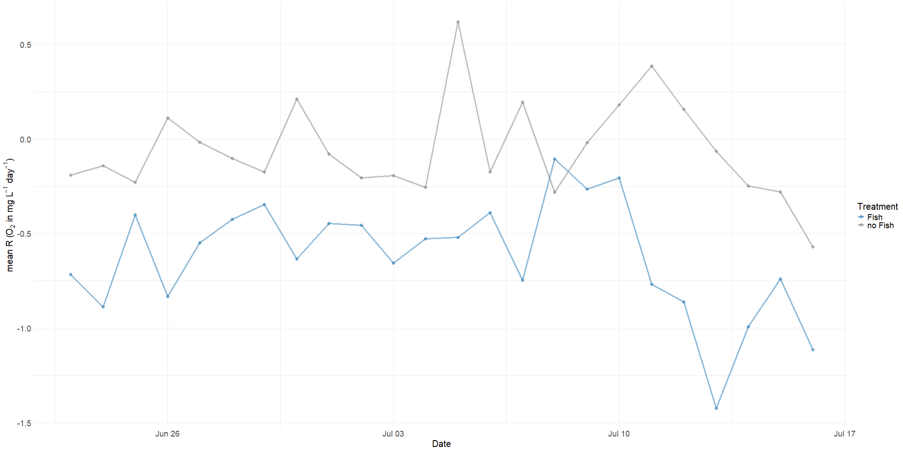
Results: R daily means 2023

Slide 20
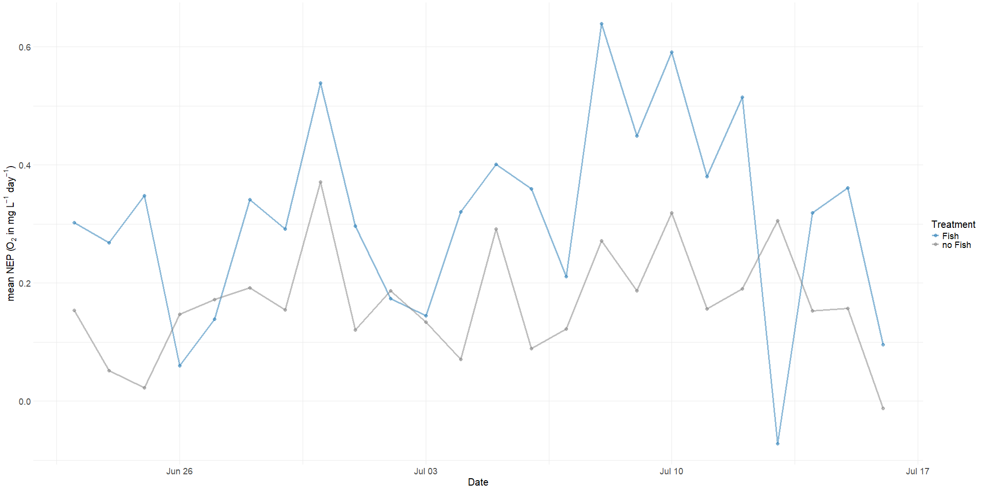
Results: NEP daily means 2023

Slide 21
Preliminary Conclusions
Sticklebacks likely increase magnitude of daily DO variation
Sticklebacks likely increase gross primary production
Sticklebacks likely increase ecosystem respiration

Slide 22
Limitations
Until now: Mixed layer depth qualitatively assessed from pond profiles
Mixed layer depth = height of surface layer with constant temperature
Used to model the gas transfer coefficient
Mixed layer is highly dependent on weather conditions
Supplied wind data should be normalized to 10m sensor height – what is the sensor height of a radiosonde?
Consider different source of wind data

Slide 23
Outlook
Optimize data input for metabolism models – minimize “noise”, maximize signal
Mixed layer depth
Wind sensor height
Deal with impossible GPP and R estimates
Investigate underlying causal mechanism leading to increased production and respiration in ponds with Sticklebacks
Think about strategies to synthesize results from 2021, 2022, and 2023

Slide 24
Appendix

Slide 25
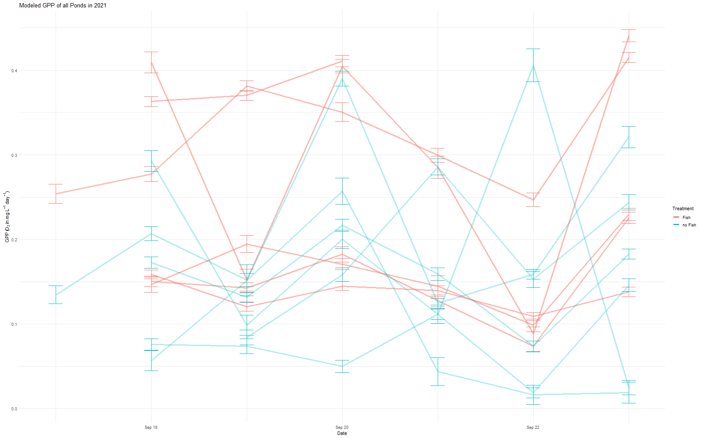
Results: GPP 2021

Slide 26
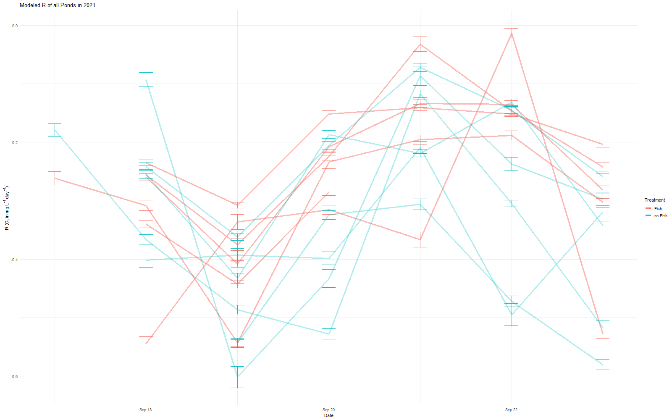
Results: R 2021

Slide 27
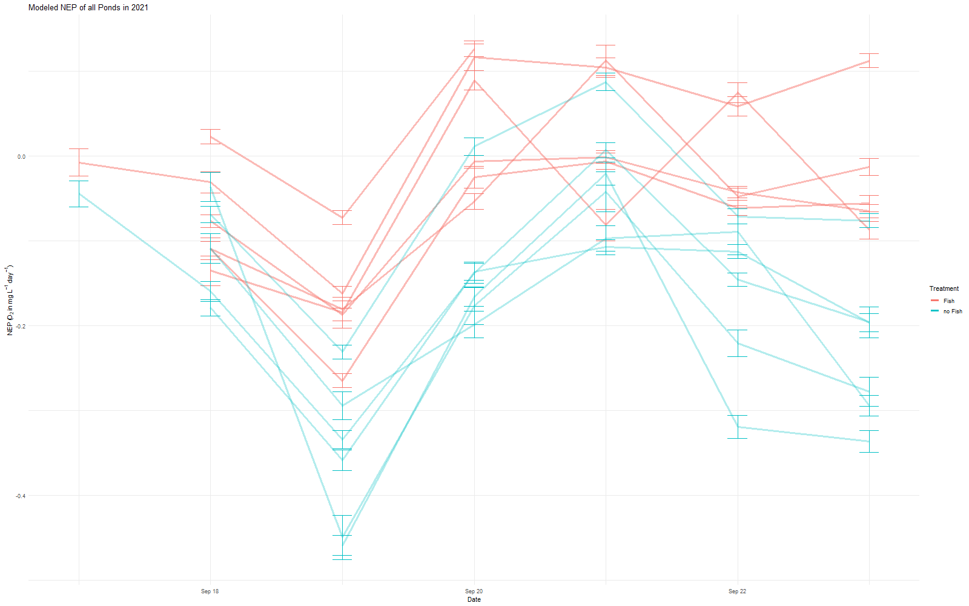
Results: NEP 2021

Slide 28
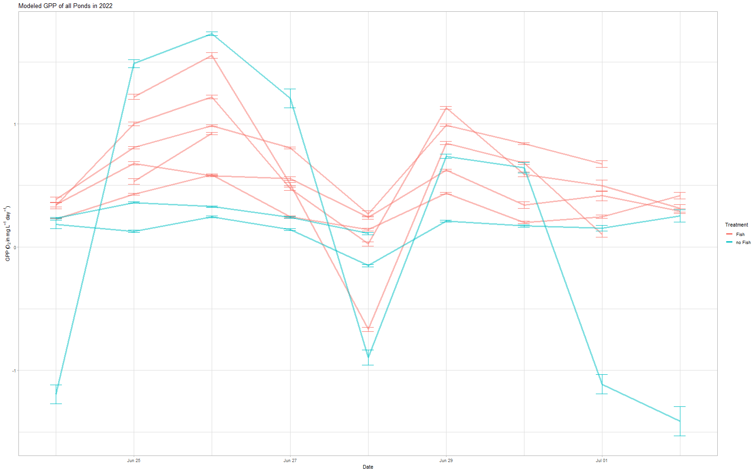
Results: GPP 2022

Slide 29
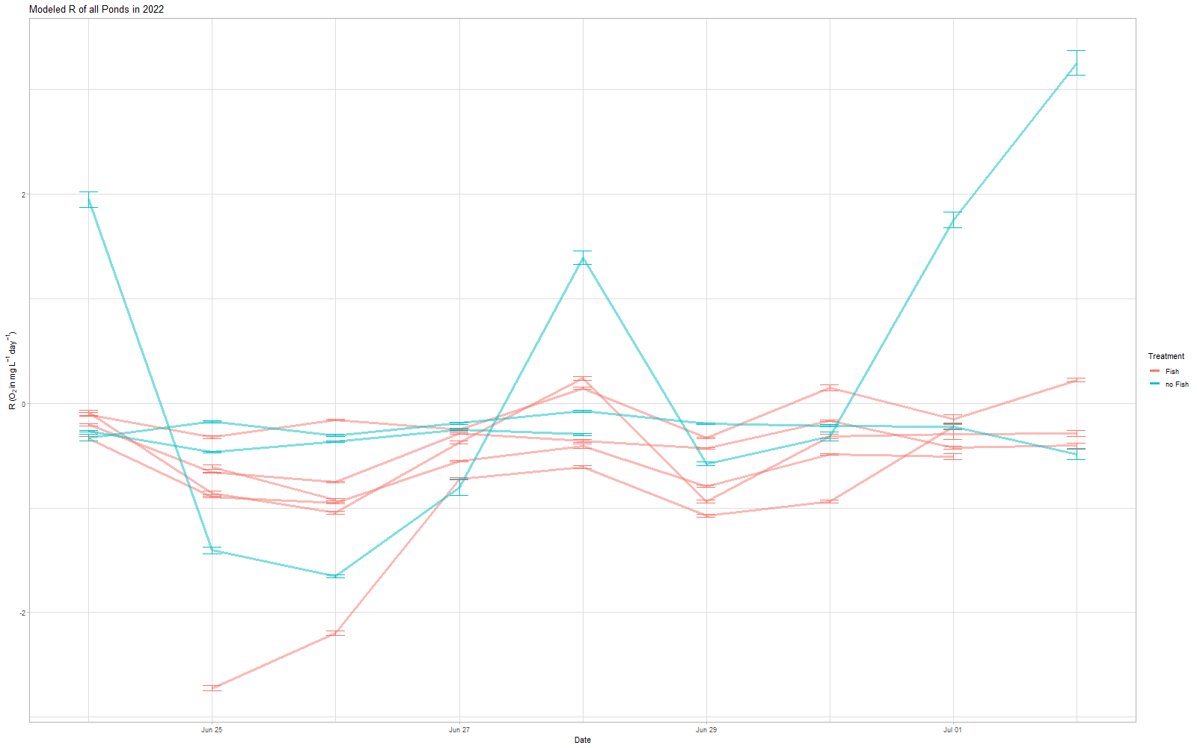
Results: R 2022

Slide 30
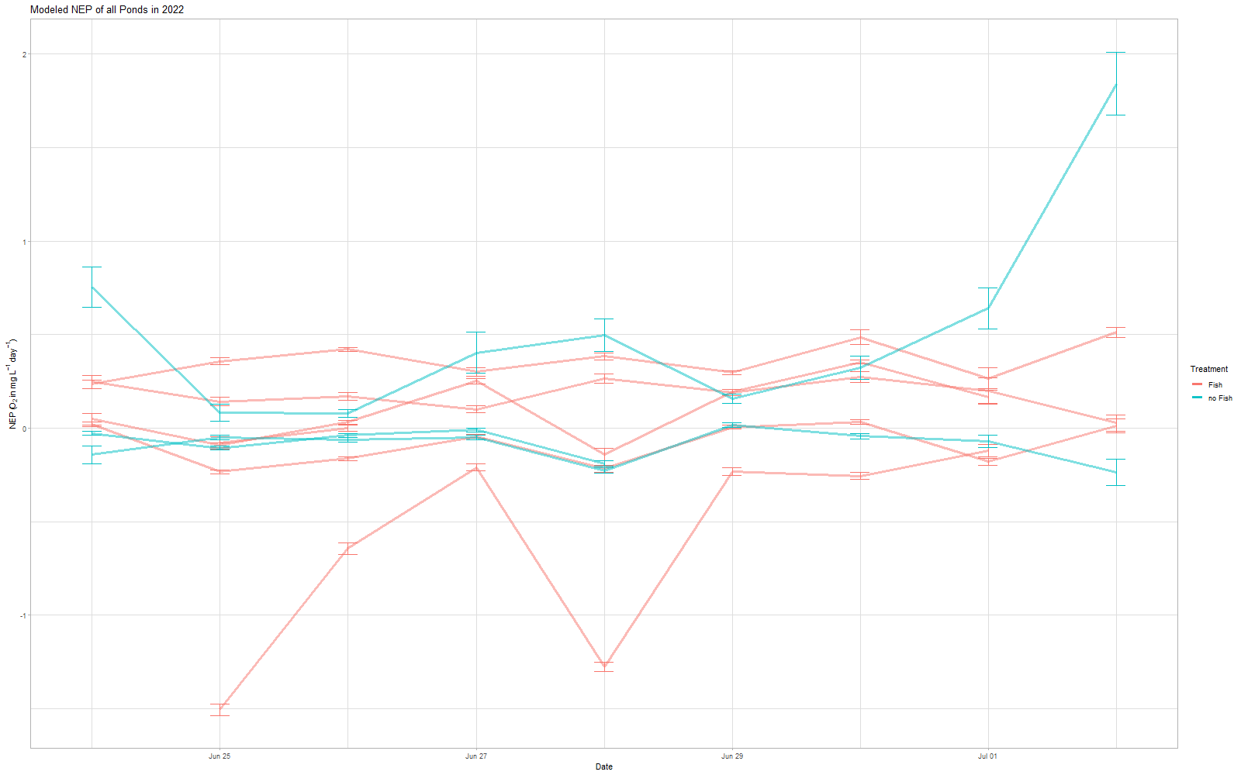
Results: NEP 2022

Slide 31
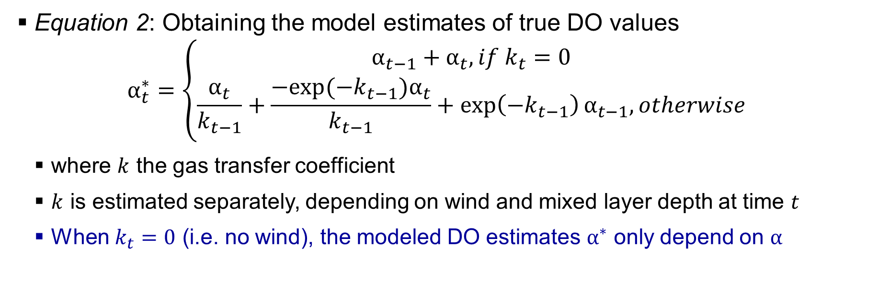
Methods: Bayesian lake metabolism model
Equation 2: Obtaining the model estimates of true DO values
$$α_{t}^{∗}=\left\{\begin{aligned}α_{t−1}+α_{t}, if k_{t}=0 \\ \frac{α_{t}}{k_{t−1}}+\frac{−exp⁡(−k_{t−1})α_{t}}{k_{t−1}}+\exp\left(−k_{t−1}\right)α_{t−1}, otherwise\end{aligned}\right.$$
where $k$ the gas transfer coefficient
$k$ is estimated separately, depending on wind and mixed layer depth at time $t$
When $k_{t}=0$ (i.e. no wind), the modeled DO estimates $α^{∗}$ only depend on $α$

